Slide 1

Machine Learning 101
Session 3: Classification with K Nearest Neighbours
Nafis Neehal, Lecturer, CSE, DIU.
Cognota.ai

Slide 2
Contents
What is Classification Problem
What is the Nearest Neighbor Problem
Generalize - KNN
Work with a simple dataset
Cognota.ai

Slide 3
Classification
Differentiate Entities
-> Can be Binary / Multi Class
Cognota.ai

Slide 4

Nearest Neighbor Problem (Consider a Village)
Cognota.ai

Slide 5
House Data (Hypothetical)
House Number | Color
1 | Red
2 | Red
3 | Green
4 | Red
5 | Green
6 | Green
7 | Red
8 | Green
9 | Red
Cognota.ai

Slide 6
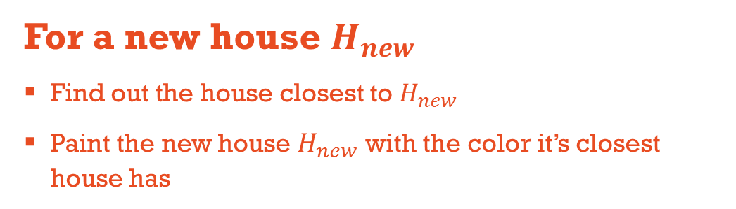
Hypothesis (Single Neighbor)
For a new house $H_{new}$
Find out the house closest to $H_{new}$
Paint the new house $H_{new}$ with the color it’s closest house has
Cognota.ai

Slide 7
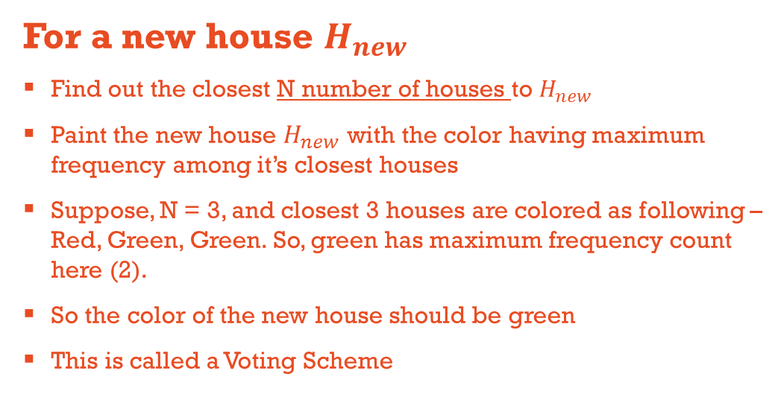
Hypothesis (N Neighbors)
For a new house $H_{new}$
Find out the closest N number of houses to $H_{new}$
Paint the new house $H_{new}$ with the color having maximum frequency among it’s closest houses
Suppose, N = 3, and closest 3 houses are colored as following – Red, Green, Green. So, green has maximum frequency count here (2).
So the color of the new house should be green
This is called a Voting Scheme
Cognota.ai

Slide 8
Simple Dataset
We will use the popular IRIS Dataset.
150 Samples
3 Classes (setosa, versicolor, virginica)
50 samples to each class
Use 100 Data Samples (it has to be random) as training and rest 50 Data Samples as training
Cognota.ai

Slide 9
Workflow
Imports
import pandas as pd
import numpy as np
from sklearn.model_selection import train_test_split
from scipy.spatial import distance
from sklearn.metrics import accuracy_score
Read the CSV file into a dataframe Save the first 4 columns in a np.array named X
Create a 150 length array filled with zeros (use np.zeros) named y
Cognota.ai

Slide 10
Workflow
Encode ‘setosa’ = 0, ‘versicolor’ = 1, ‘virginica’ = 2 in y array
Randomly save 100 samples in X_train and rest 50 samples in X_test. Same for y_train and y_test. Use train_test_split() function for this
For each element in X_test
Calculate it’s distance from all the points in X_train
Choose the closest K values
Find the max_frequency class value and assign
Finally, check the accuracy. Accuracy_score(y_test, y_predict) will return an accuracy value
Cognota.ai

